Slide 1
Data Mining Project Progress Report
Group Doreamon:
Abdul Gafar Manuel Meque
Chih-Ming Chen
Sachit Mahajan

Slide 2
Work flow
Extracted features:
1. Vector Space Model
2. Latent Topic Model
Feature
Extraction (Methodology)
Train
Data
Feature Set
80%
Reddit
Dataset
Data Cleaning e.g. removing stop words
Classifier
Statistics
Test
Data
20%
Data Analysis,
Feature Analysis
Viaualization
Assistant
Resources
Predictions
Data Visualization:
1. Histogram
2. Word Cloud
3. Clustering
Opinion
Lexicon
Emotion
Lexicon
…
WordNet
Python NLTK
Algorithm Comparison,
Performance Evaluation
Accuracy

Slide 3
Work flow
Reddit
Dataset
Text Preprocessing + Feature Extraction
Patterns
Result
Analysis
Assistant
Resources
Data Analysis,
Feature Analysis
Visualization
Opinion
Lexicon
Emotion
Lexicon
…
WordNet
Python NLTK

Slide 4
Work flow
Reddit
Dataset
Text Preprocessing + Feature Extraction
Patterns
Result
Analysis
Assistant
Resources
Data Analysis,
Feature Analysis
Visualization
Opinion
Lexicon
Emotion
Lexicon
…
WordNet
Python NLTK

Slide 5
Problem Description
What Knowledge?
Given a Post p with upvotes u and downvotes d
Can we predict the opinion polarity (negative | positive) based on u & d?
P(p=negative|u,d)
P(p=positive|u,d)
Can we Predict the u,d distribution based on p?
P(u,d|p)
The relationship between post emotion/polarity and its words under different subreddits.

Slide 6
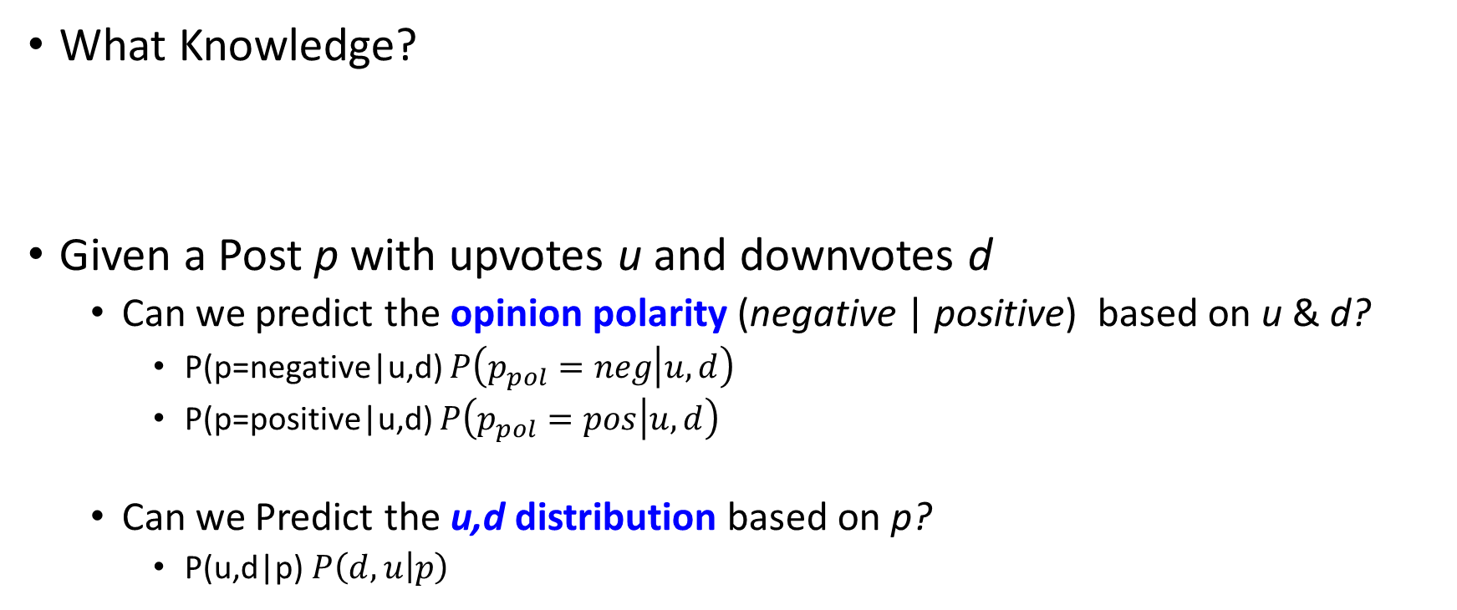
Problem Description
What Knowledge?
Given a Post p with upvotesu and downvotesd
Can we predict the opinion polarity (negative | positive) based on u &d?
P(p=negative|u,d) $P\left(p_{pol}=neg | u,d\right)$
P(p=positive|u,d) $P\left(p_{pol}=pos | u,d\right)$
Can we Predict the u,ddistribution based on p?
P(u,d|p) $P\left(d,u | p\right)$
The relationship between a word and its polarity under different subreddit.

Slide 7
Preprocessing
1stStep- Remove all non English comments by using language detection tool called TextBlob.
2ndStep- Parse Comments
Parse text in the comments. To solve contraction problem so that parser can parse properly.
3rd Step- Language related processing. Take the body of the comment. Get list of words (tokenize) and remove stop words.

Slide 8
Preprocessing
4th Step- This is the extraction part. Get important things from each body. Sentences, anagrams, noun-phrases.
Feature Extraction- Here we extract sentiment objects. Check the text, find a list of positive words, list of negative words and polarities (negative, positive, neutral).
* Score is not from the body.
# of subreddits: 171 (the most popular), randomly select 2,000 comments for each

Slide 9
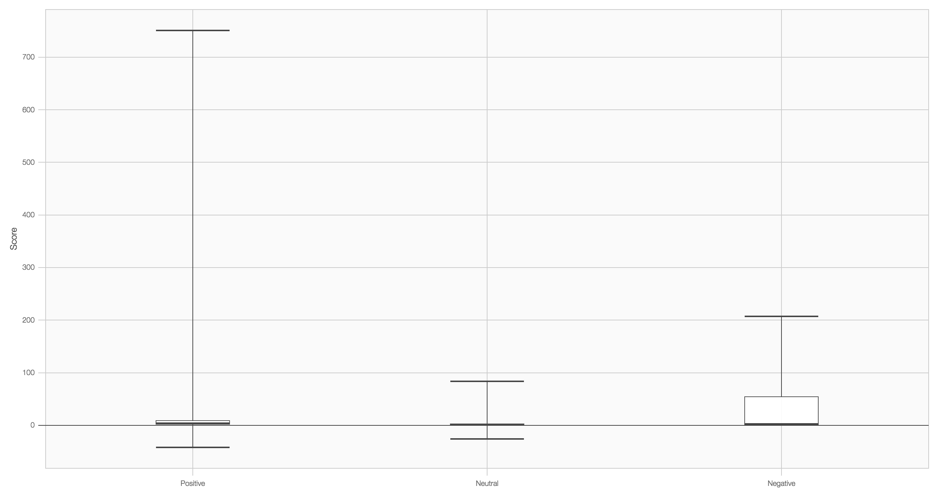
Sentiment to Score: Boxplot
FIFA.
Score
Positive
Neutral
Negative

Slide 10
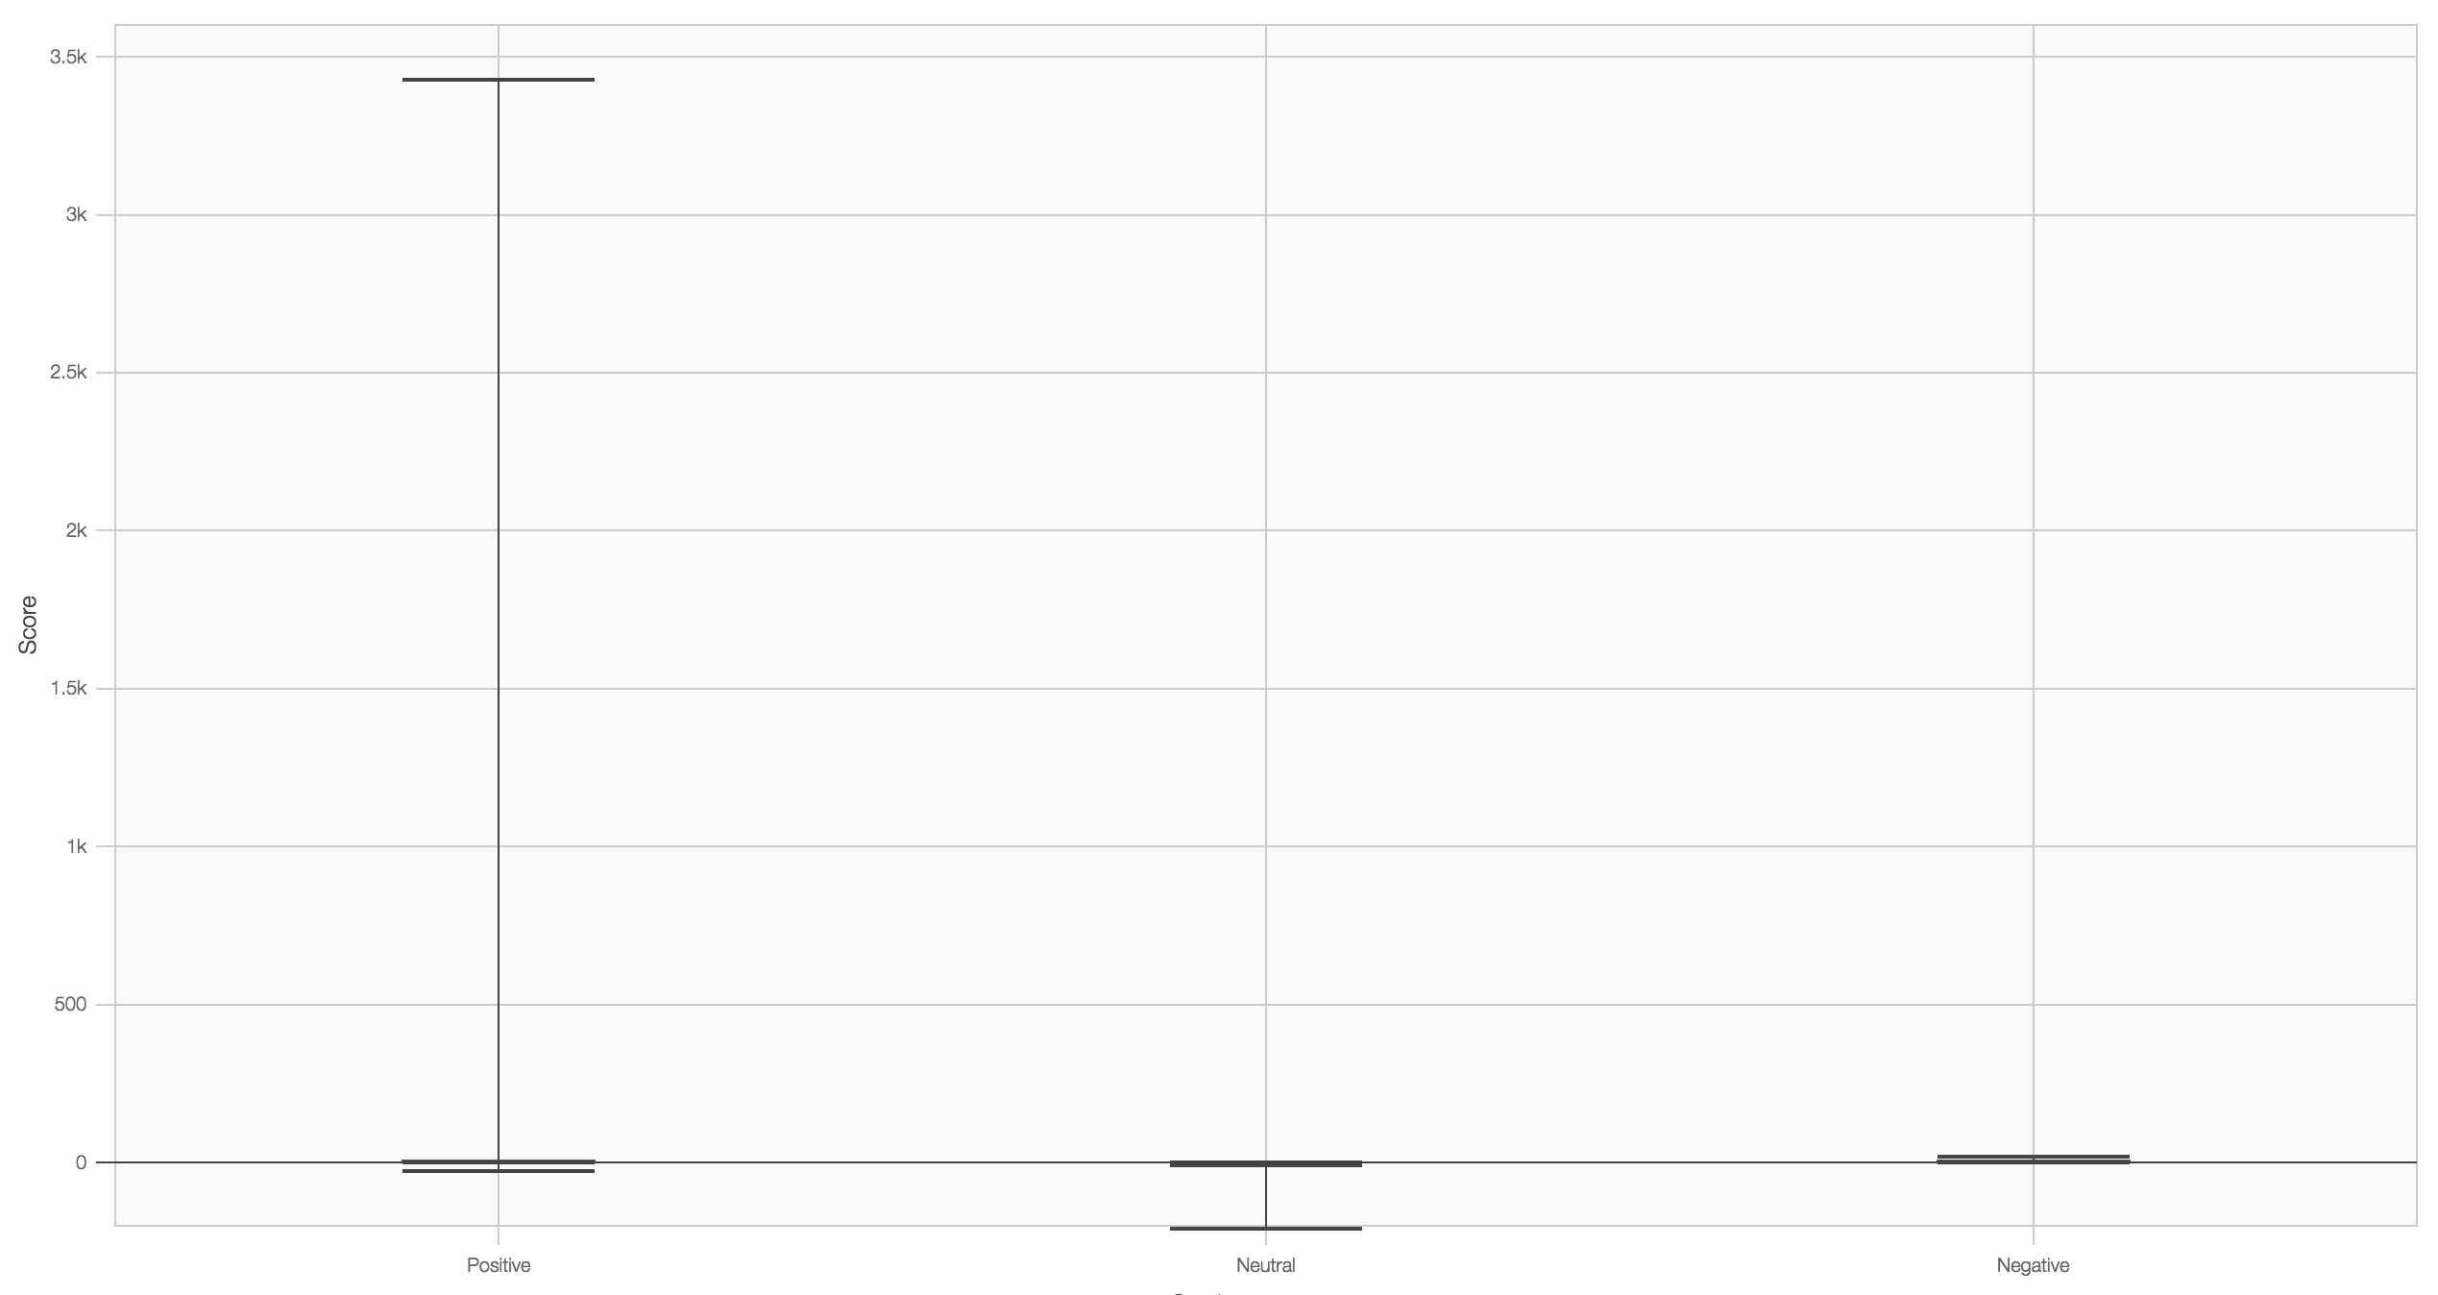
Sentiment to Score: Boxplot
Science.
Score
Positive
Neutral
Negative

Slide 11
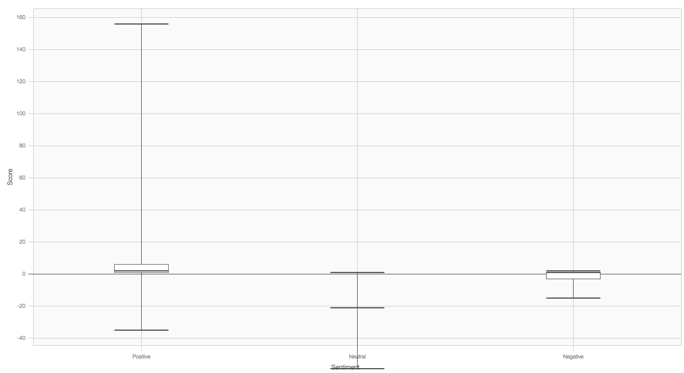
Sentiment to Score: Boxplot
Boxing.
Score
Positive
Neutral
Negative

Slide 12
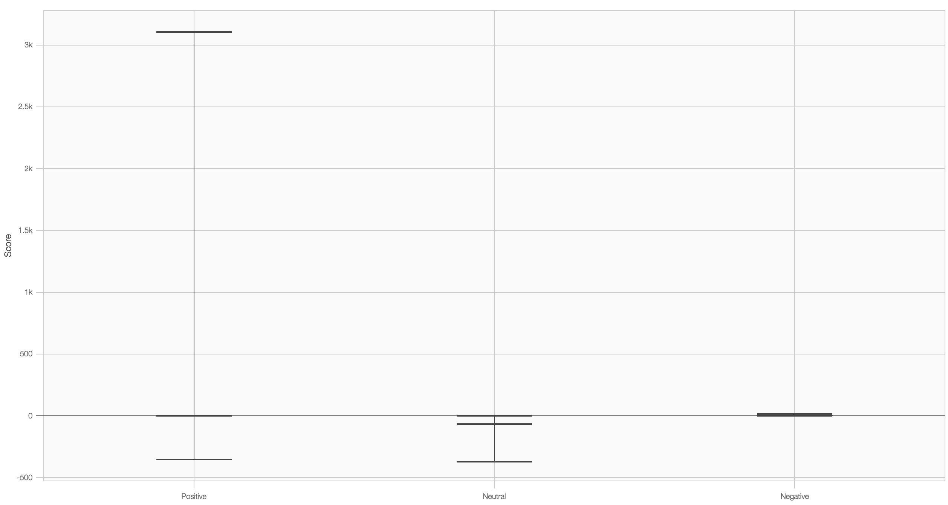
Sentiment to Score: Boxplot
Music.
Score
Positive
Neutral
Negative

Slide 13
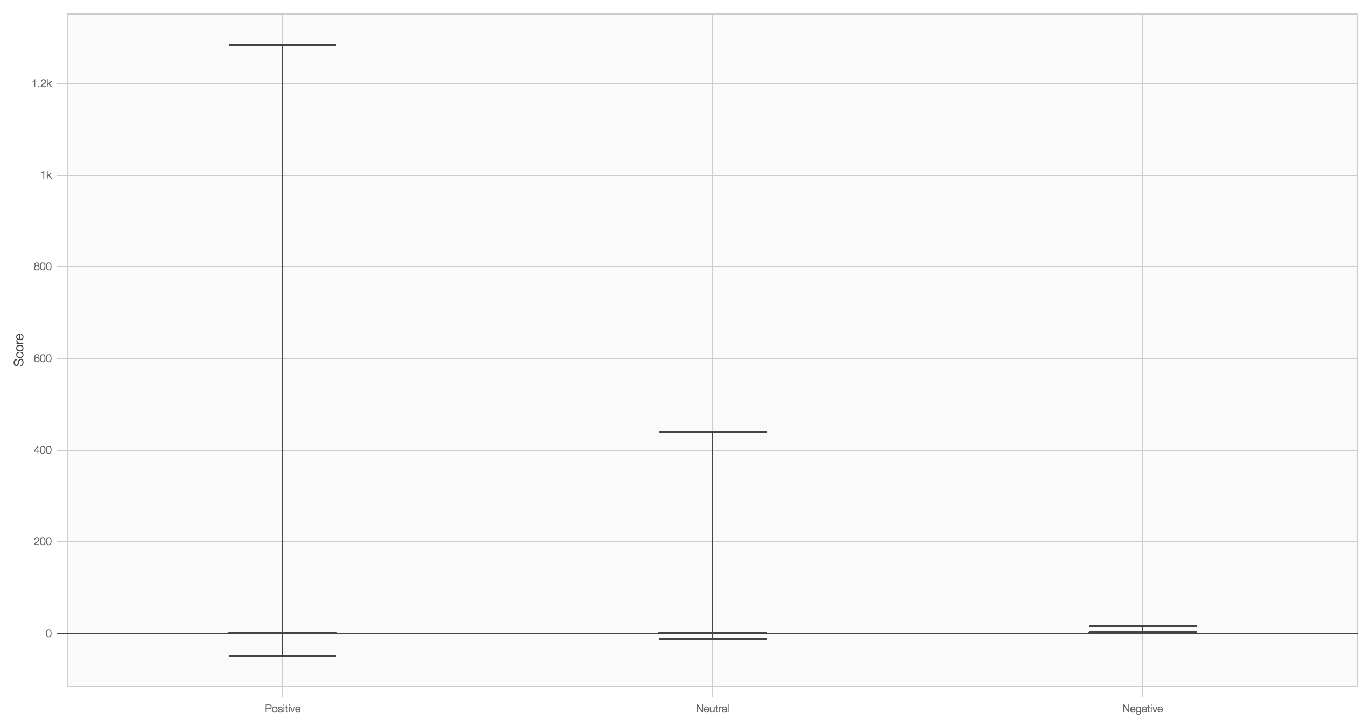
Sentiment to Score: Boxplot
gifs.
Score
Positive
Neutral
Negative

Slide 14
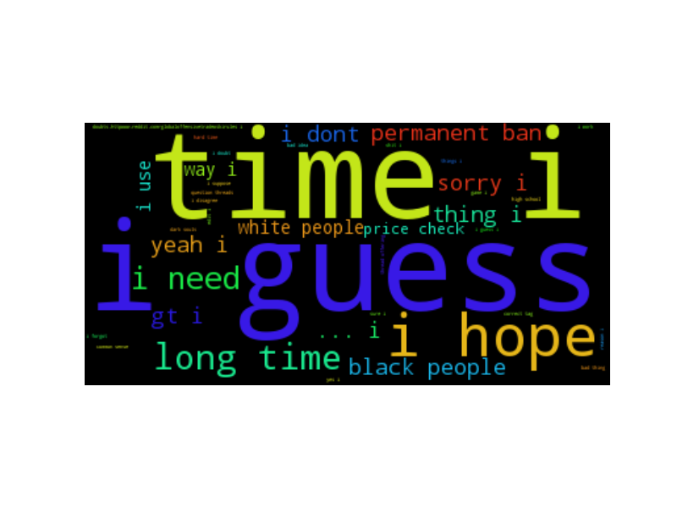
Negative Noun-Phrases Distribution

Slide 15
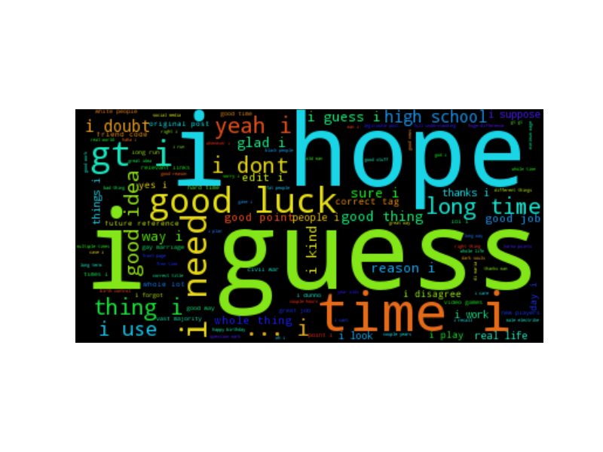
Positive Noun-Phrases Distribution

Slide 16
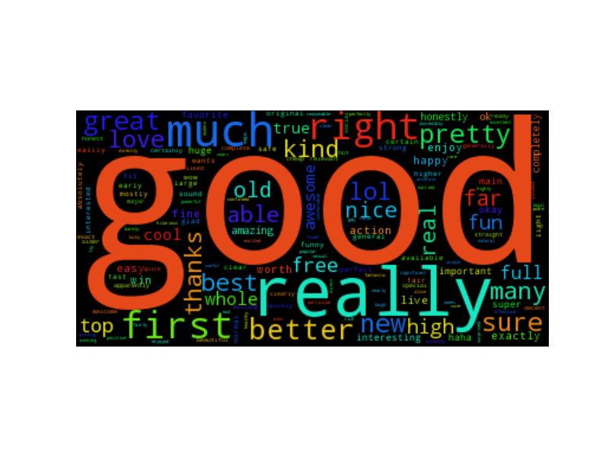
Positive Words Distribution

Slide 17
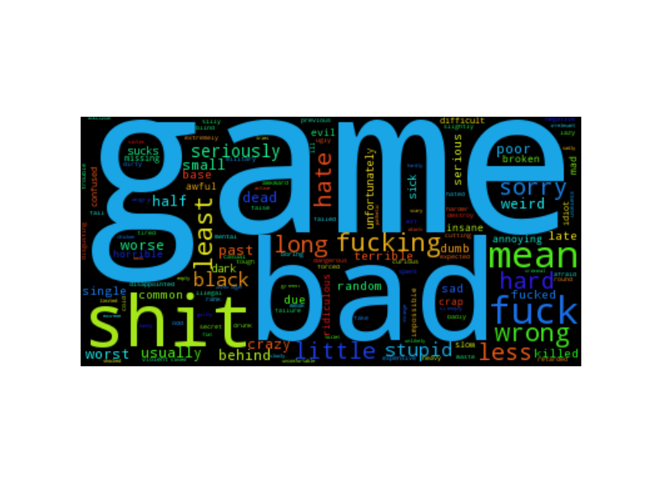
Negative Words Distribution

Slide 18
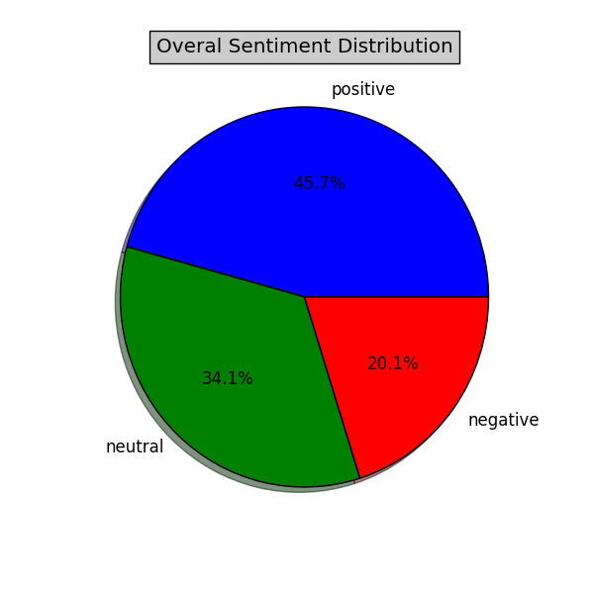
Overall Sentiment Distribution

